Slide 1
CT026-3-2
Human Computer Interaction
Human Computer Interaction
User Profiling
Level 2
Prepared by: RZW First Prepared on: December, 2007 Last Modified on: Feb 2018
Quality checked by: MOH
Copyright 2004 Asia Pacific Institute of Information Technology

Slide 2
Topic and Structure of the Lesson
Reasons for User Profiling
Data Gathering Techniques
User Profiling activity

Slide 3
Learning Outcomes
At the end of this module, YOU should be able to:
  Explain the reasons for doing User Profiling
  Describe the various data gathering techniques
  Identify problems with data gathering
  Perform user profiling activity

Slide 4
Key Terms you must be able to use
If you have mastered this topic, you should be able to use the following terms correctly in your assignments and exams :
User Profiling
Questionnaires
Interview
Observation
Requirement Analysis

Slide 5
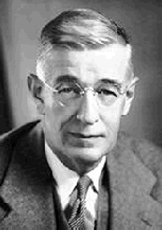
User
“One most unfortunate product is the type of engineer who does not realize that in order to apply the fruits of science for the benefit of mankind, he must not only grasp the principles of science, but must also know the needs and aspirations, the possibilities and the frailties, of those whom he would serve.”
-- Vannevar Bush
1890-1974, well known
American Electrical engineer
Directed programs like the first development of atomic bombs , mass production of penicillin

Slide 6
Usability Engineering Lifecycle
User Input via User Profiling
Original Product Concept
Exploring other requirement (task analysis, usability goals & competitive analysis)
Parallel Design Sketches
Participitory Design – more input from users/designers
First Prototype
User Input via Evaluation
(Formative)
Iterative Design Versions
Final Released Product
User Input via Evaluation (Summative)

Slide 7
What is User Profiling?
The process of establishing knowledge about the users
Find out
who users are
  Children, Elderly, Professional, Scientist, Male, Female, Tech Savvy, IT Illiterate
what is the goal in using the product
  Withdraw cash, pay bills, find out movie time, online chat, gaming, research, cook, wash, treatment
what are the tasks involved? (observe existing work practices)
  To apply for leave: check schedule, get leave application form from admin, fill in the form, get supervisor to approve, get manager to approve, inform scheduler, inform colleagues, go on leave.

Slide 8
Why do User Profiling?
Why do user profiling, why not define “good” interfaces and just based your design on them?
  infinite variety of tasks and users
  guidelines can be too vague to be generative
    e.g.,
    “give adequate feedback”, “make the system enjoyable” – how do you define the above guidelines and relate to users?”

Slide 9
User Profiling
Captures the characteristics of the intended user group
Try to categorize your user into one of the three categories: (based on skill & competence)
  Novice (clear step by step intro)
  Intermediate / Casual (
  Expert & Frequent (flexible interactions, wide range of power/control, short cut keys)

Slide 10
What do we want to know -Who are the Users?
Identify attributes of users
  Physical characteristics
    height; physical abilities or disabilities
  Background
    education; social; religious
  Skills
    task experience
  Preferences
    efficiency

Slide 11
What do we want to know - Where is the Task Performed?
Office, laboratory, POS? (while standing, while sitting, in a crowded place, effects of environment)
Are users under stress? (in an operation theatre)
Is confidentiality required? (information displayed)
Do Users have wet hands? (at the butcher)
Do Users consume drinks while doing tasks?
What kind of lighting do they work under?
Surrounding noise

Slide 12
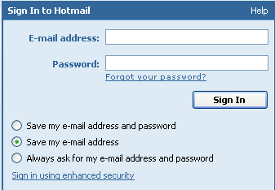

What do we want to know - Relationship Between Users & Data?
Personal data
  always accessed at same machine?
  do users move between machines?
Common data
  used concurrently?
  Passed sequentially between users?
Access to data restricted?

Slide 13
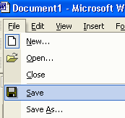
What do we want to know - How Often are Tasks Performed?
Frequent users remember more details
Infrequent users may need more help
  even for simple operations
Which function is performed
  most frequently?
  by which users?
  optimize system for these tasks will improve perception of good performance

Slide 14
What do we want to know - What are the Time Constraints?
What functions will users be in a hurry for?
  Positioning of functions (in video games)
Which can wait?
Is there a timing relationship between tasks?
  Time out

Slide 15
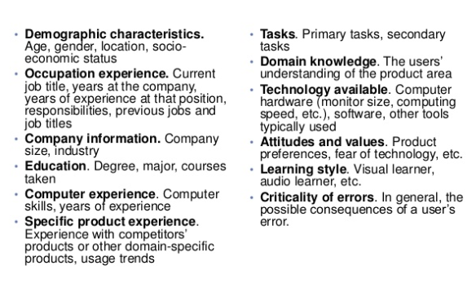
User Profiling Summarized
Once you determine the range of responses for each of the characteristics and the percentage of users along that range, you will want to categorize it into graoup based on their similarities, such as :

Slide 16
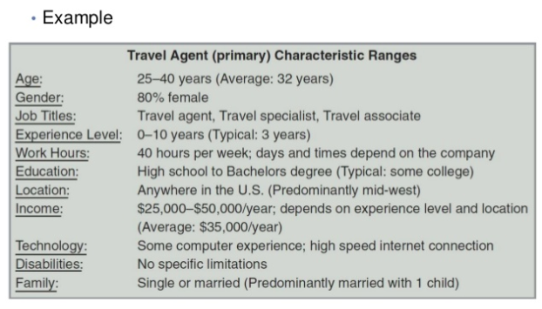
User Profiling Outcome Example

Slide 17
Data Gathering
What:
How do we go about determining requirements
and concluding the results
An important part of the requirement activity
and also evaluation activity
Why:
Purpose is to collect sufficient, relevant and
appropriate data to produce a set of reliable
requirements/conclusions – User Requirement Data Derivation

Slide 18
Data Gathering Techniques
Technique | Good For | Kind Of Data | Advantages | Disadvantage
Questionnaire | Answering specific question | Quantitative and qualitative data | Can reach many people with low resources | The design is crucial. Response rate may be low. Responses may not be what you want.
Interviews | Exploring issues | Some quantitative but mostly qualitative data | Interviewer can guide interviewee if necessary. Encourages contact between developers and user | Time consuming. Artificial environment may intimidate interviewee.
Focus group and workshops | Collecting multiple viewpoints | Some quantitative but mostly qualitative data | Highlight areas of consensus and conflict. Encourages contact between developers and users | Possibility of dominant character
Naturalistic observation | Understanding context of user activity | Qualitative | Observing actual work gives insights that other techniques can’t give | Very time consuming. Huge amount of data
Studying documentation | Learning about procedures, regulations and standards | Quantitative | No time commitment from user required | Day to day working will differ from documented procedures.

Slide 19
Problems with Data Gathering
Identifying and involving stakeholders
Availability of key people
Communication between parties
  Within development team (more technical)
  With customer/user (less technical)
  Between users (different parts of an organisation use different terminology)
Dominance of certain stakeholders
Balancing functional and usability demands

Slide 20
Choosing Data Gathering Techniques
Choosing the techniques can be look into this 2 issues:
  The amount of time they take and the level of detail and risk associated with the finding. Example, it is claim that a naturalistic observation will take two days effort and three month of training while interviews take one day effort and one month of training.
  The knowledge the analyst must have about basic cognitive processes.

Slide 21
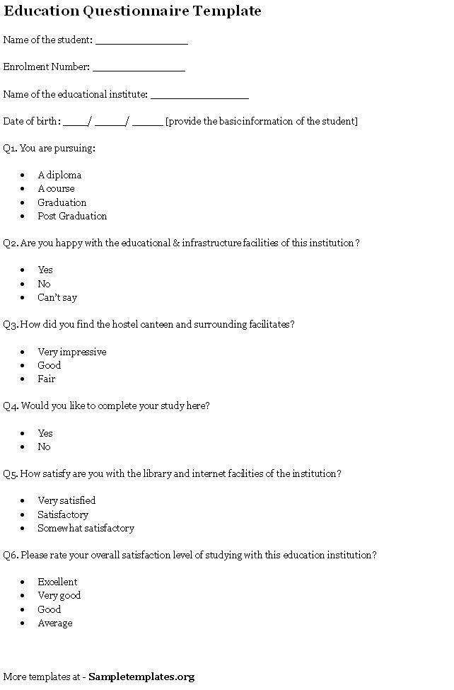
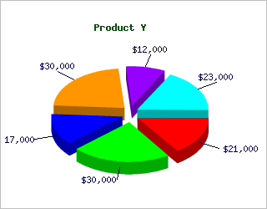
Questionnaire Sample
Question : | What is your age ?
Justification : | Finding the age range of the targeted audience.
Analysis : | 20 – 30 yrs - 20% 30 – 50 yrs – 80%
Impact : | Due to the analysis result above, the data is to help in creating the user profile for the proposed system in understanding about the user.

Slide 22
Interview Sample
Interviewee’s name: Mr Smith James
Age: 28
Date: 1/October/2010
Venue: APIIT’s Library syndicate room
Question: What is the biggest drawback to the current library system?
Analysis
Response: Inability to search the bookshelf by Title, Author or ISBN.
Impact on the design: Include in the modified design the ability to search by Title, Author and ISBN.

Slide 23
Observation Sample
Actions / Events | Observation
Making a bill payment to ASTRO | After logging in the user checks the menus to identify if he was able to view any menu regarding the task that he was assigned. After spending around 30 seconds reading the main menu titles and details he pressed the Accountings & banking menu. Here the balance was visible. So the user went back again and read the text explaining the Accountings & Banking option and again clicked it. After looking around the page for a few seconds he selected the Bill Payment option which was available on the left side of the screen. The choice to make a one-off payment was available to him when the page loaded so he selected in at once. After selecting the one-off payment option the user selected Astro from a list of top 9 payees that were listed on the screen. In the next page the user entered the amount, selected and entered the bill account number and clicked continue. Then the user had to enter a TAC number there was the option for a TAC request so the user selected the option and another screen opened. From here the user requested the TAC number and the screen is closed then the user press the confirm button to finish the task.

Slide 24
Observation Sample Cont..
Discussion | Impact
From the observations it was found that the users became frustrated with the number of steps which were involved in completing the processes. In addition to that the users also found it frustrating that they were unable to identify the submenus within the main menus. . | The redesigned process will reduce the number of steps needed to complete the process

Slide 25
Question and Answer Session
Q & A

Slide 26
Next Session
Topic and Structure of next session
Task Analysis

